Slide 1
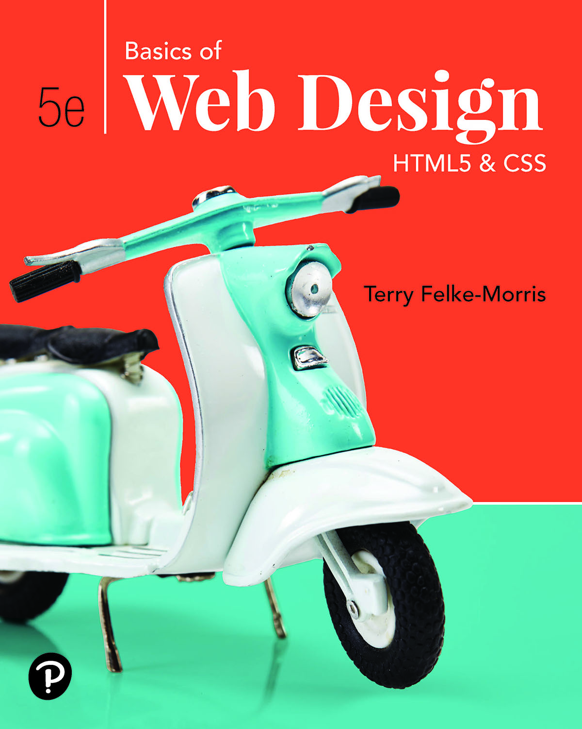
Basics of Web Design
Fifth Edition
Chapter 3
Web Design Basics Key Concepts
Slide in this Presentation Contain Hyperlinks. JAWS users should be able to get a list of links by using INSERT+F7
Copyright © 2019 Pearson Education, Inc. All Rights Reserved
Notes:
If this PowerPoint presentation contains mathematical equations, you may need to check that your computer has the following installed:
1) Math Type Plugin
2) Math Player (free versions available)
3) NVDA Reader (free versions available)

Slide 2
Learning Outcomes
Describe the most common types of website organization
Describe principles of visual design
Design for your target audience
Create clear, easy-to-use navigation
Improve the readability of the text on your web pages
Use graphics appropriately on web pages
Apply the concept of Universal Design to web pages
Describe web page layout design techniques
Describe the concept of responsive web design
Apply best practices of web design

Slide 3
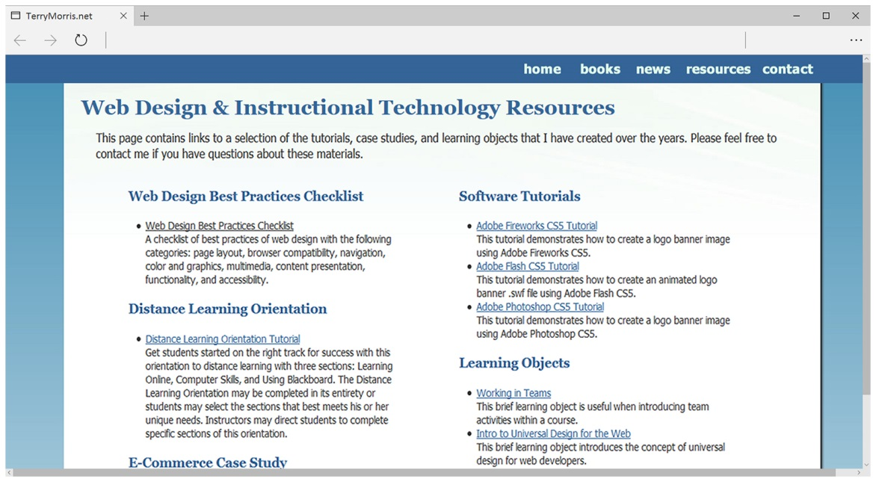
Design for Your Target Audience
Consider the target audience of these sites.

Slide 4
Web Page Design Browser Compatibility
Web pages do NOT look the same in all the major browsers
Test with current and recent versions of:
Microsoft Edge, Firefox, Chrome, Opera, Safari
Mobile devices
Progressive Enhancement:
Website functions well in browsers commonly used by your target audience
Add enhancements with C S S and/or H T M L 5 for display in modern browsers

Slide 5
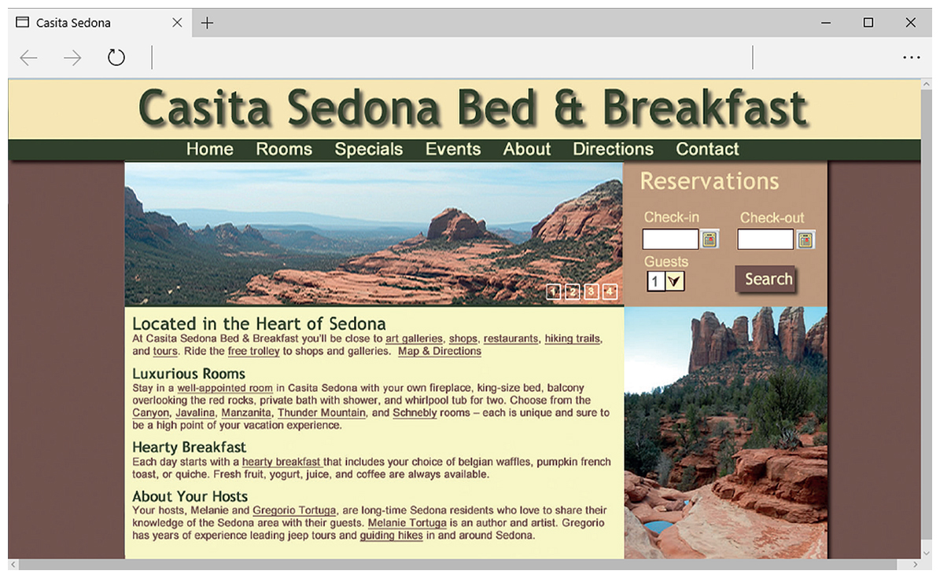
Web Page Design Screen Resolution
Test at various screen resolutions
Design to look good at various screen resolutions
Centered page content
Set to either a fixed or percentage width

Slide 6
Website Organization
Hierarchical
Linear
Random (sometimes called Web Organization)

Slide 7
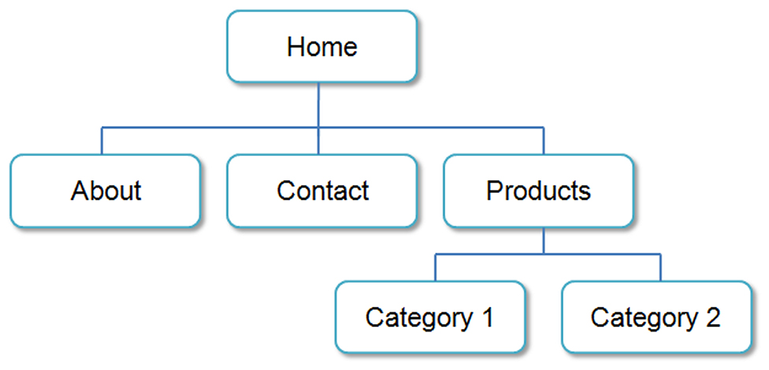
Hierarchical Organization
A clearly defined home page
Navigation links to major site sections
Often used for commercial and corporate websites

Slide 8
Hierarchical: Too Shallow
Be careful that the organization is not too shallow.
Too many immediate choices → a confusing and less usable website.
Group, or “chunk”, related areas

Slide 9
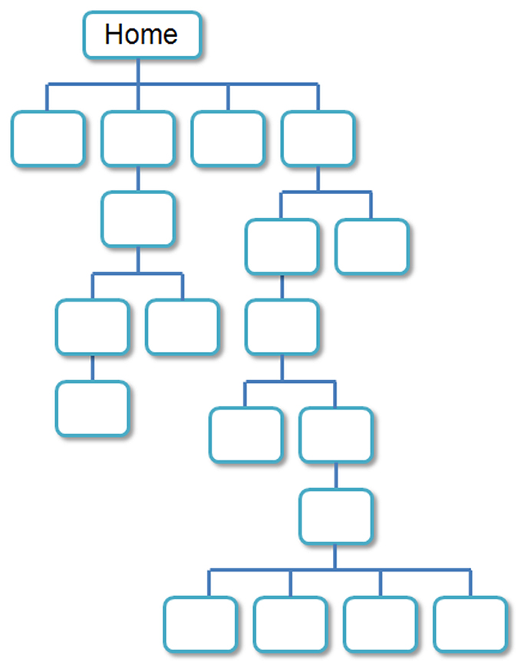
Hierarchical: Too Deep
Be careful that the organization is not too deep.
This results in many “clicks” needed to drill down to the needed page.
User Interface “Three Click Rule”
A web page visitor should be able to get from any page on your site to any other page on your site with a maximum of three hyperlinks.

Slide 10
Linear Organization
A series of pages that provide a tutorial, tour, or presentation.
Sequential viewing

Slide 11
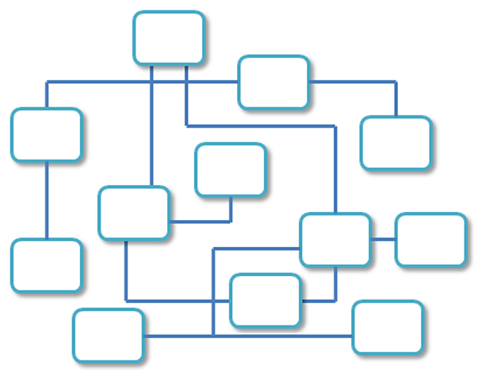
Random Organization
Sometimes called “Web” Organization
Usually there is no clear path through the site
May be used with artistic or concept sites
Not typically used for commercial sites

Slide 12
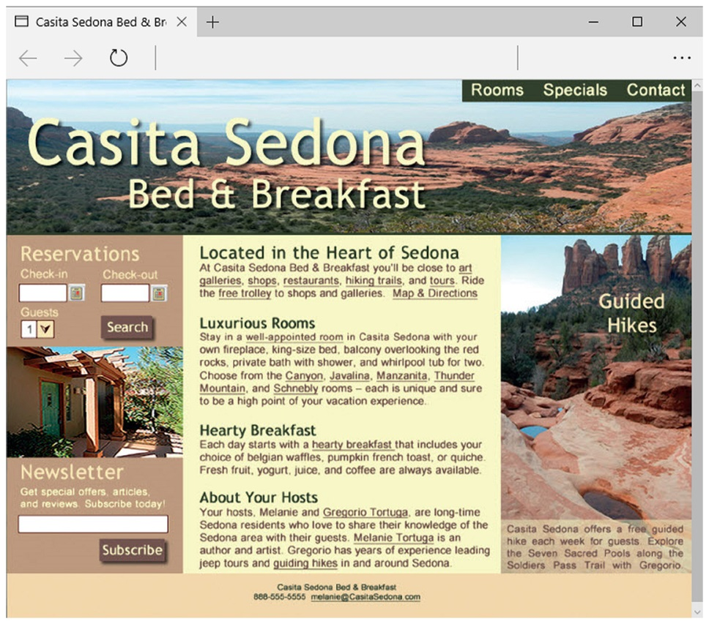
Visual Design Principles
Repetition
Repeat visual elements throughout design
Contrast
Add visual excitement and draw attention
Proximity
Group related items
Alignment
Align elements to create visual unity

Slide 13
Design to Provide for Accessibility
“The power of the Web is in its universality. Access by everyone regardless of disability is an essential aspect.”
– Tim Berners-Lee
Who benefits from increased accessibility?
A person with a physical disability
A person using a slow Internet connection
A person using an old, out-dated computer
A person using a mobile phone
Legal Requirement: Section 508
Standards: W C A G 2.0, W C A G 2.1

Slide 14
Design for Accessibility
Web Content Accessibility Guidelines 2.0 (WCAG 2.0)
http://www.w3.org/TR/WCAG20/Overview
http://www.w3.org/WAI/WCAG20/quickref
Based on Four Principles (POUR)
Perceivable
Content must be easy to see or hear
Operable
Interface components in the content must be operable by both mouse and keyboard
Understandable
Content and controls must be easy to read and well-organized
Robust.
Content use correct syntax and function on popular operating systems, browsers, and assistive technologies.

Slide 15
Writing for the Web
Avoid long blocks of text
Use bullet points
Use headings and subheadings
Use short paragraphs

Slide 16
Design “Easy to Read” Text
Use common fonts:
Arial, Helvetica, Verdana, Times New Roman
Use appropriate text size:
medium, 1em, 100%
Use appropriate line length
Between 50-60 characters is recommended
Use strong contrast between text & background
Use columns instead of wide areas of horizontal text

Slide 17
More Text Design Considerations
Carefully choose text in hyperlinks
Avoid “click here”
Hyperlink key words or phrases
Do not hyperlink not entire sentences
Chek yur spellin (Check your spelling)

Slide 18
Using Color on Web Pages
Computer monitors display color as intensities of red, green, and blue light
R G B Color
The values of red, green, and blue vary from 0 to 255.
Hexadecimal numbers (base 16) represent these color values.

Slide 19
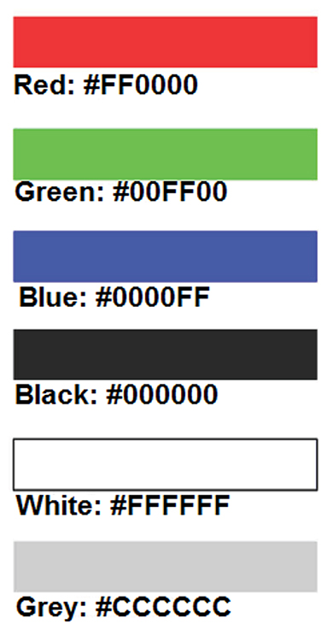
Hexadecimal Color Values
# indicates a hexadecimal value
Hex value pairs range from 00 to F F
Three hex value pairs describe an R G B color

Slide 20
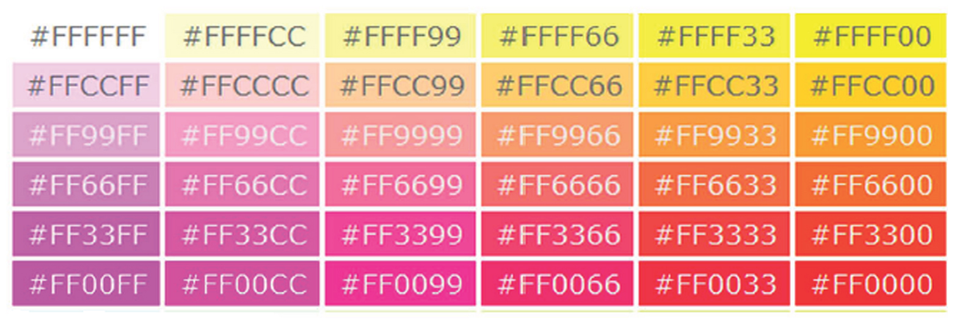
Web Color Palette
A collection of 216 colors
Display the most similar on the Mac and P C platforms
Hex values:
00, 33, 66, 99, C C, F F
Color Chart : http://webdevbasics.net/color

Slide 21
Color Theory
Color Theory:
the study of color and its use in design
Color Wheel
Primary Colors
Secondary Colors
Tertiary Colors

Slide 22
Color Schemes Based on The Color Wheel (1 of 2)
Monochromatic – shades, tints, or tones of the same color http://meyerweb.com/eric/tools/color-blend
Analogous – a main color and two colors adjacent to it on the color wheel
Complementary – two colors that are opposite each other on the color wheel

Slide 23
Color Schemes Based on The Color Wheel (2 of 2)
Split Complementary – a main color, the color opposite it on the color wheel (the complement) and two colors adjacent to the complement
Triadic- three colors that are equidistant on the color wheel
Tetradic – two complementary color pairs

Slide 24
Implementing a Color Scheme
Choose one color to be dominant
Use other colors in the color scheme as accent colors
headings,
subheadings
borders,
list markers, etc.
Use neutrals such as white, off-white, gray, black, or brown
Do not restrict yourself to web-safe colors
Feel free to use tints, shades, or tones of colors

Slide 25
Verify Sufficient Contrast
When you choose colors for text and background, sufficient contrast is needed so that the text is easy to read.
Use one of the following online tools to verify contrast:
http://webaim.org/resources/contrastchecker
http://snook.ca/technical/colour_contrast/colour.html
http://juicystudio.com/services/luminositycontrastratio.php

Slide 26
Making Color Choices
How to choose a color scheme?
Monochromatic
http://meyerweb.com/eric/tools/color-blend
http://www.0to255.com
Choose from a photograph or other image
http://www.colr.org
Begin with a favorite color
Use one of the sites below to choose other colors
http://paletton.com
http://www.colorsontheweb.com/Color-Tools/Color-Wizard

Slide 27
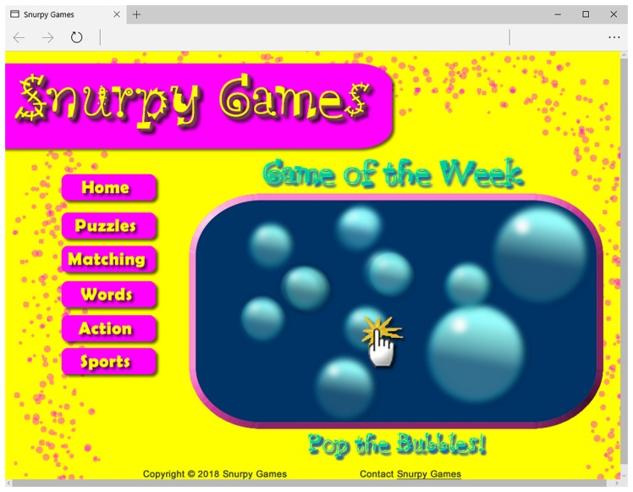
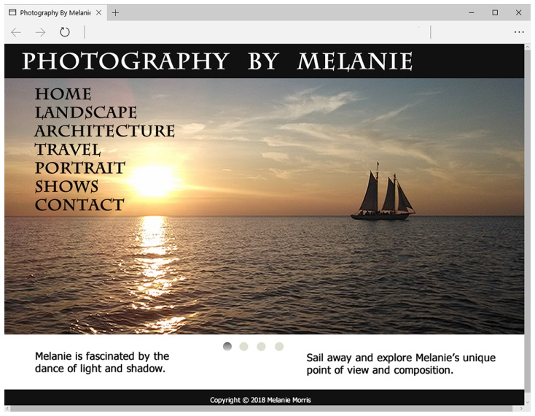
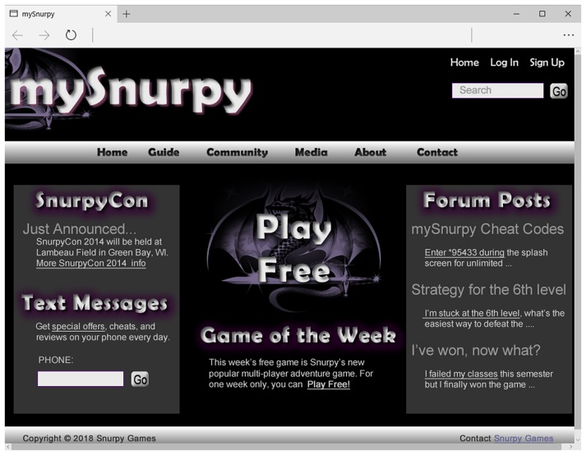
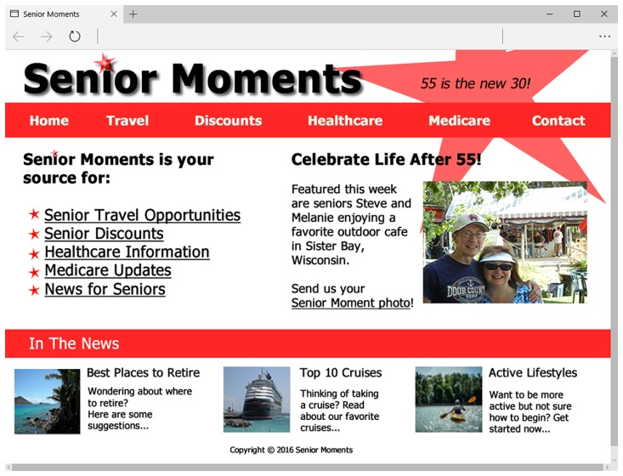
Use of Color
Appealing to Kids & Preteens
Appealing to Everyone
Appealing to Young Adults
Appealing to Older Adults

Slide 28
Use of Graphics & Multimedia
File size and dimension matter
Provide for robust navigation
Antialiased/aliased text considerations
Provide alternate text
Use only necessary multimedia

Slide 29
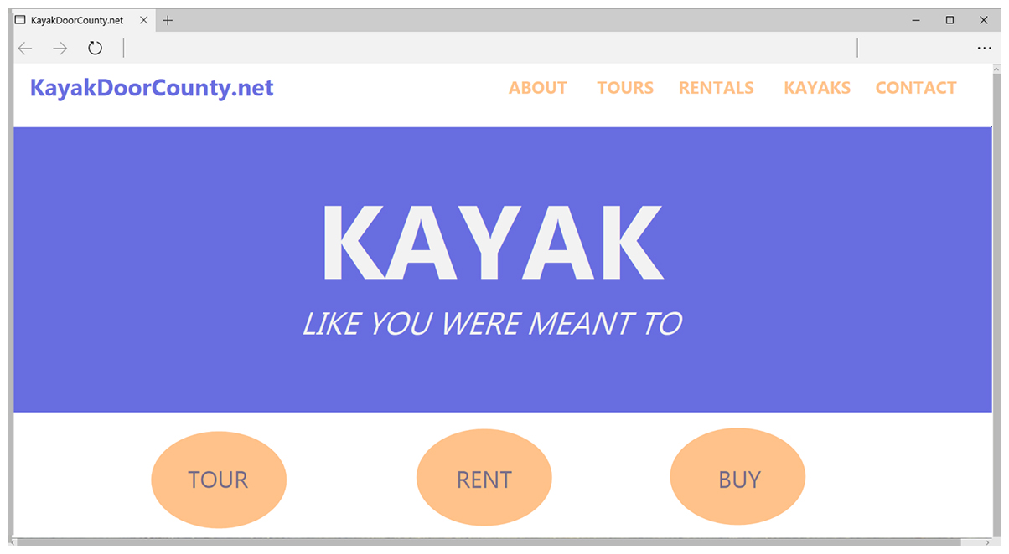
Flat Web Design Trend
Minimalistic design style
Features blocks of color
Often requires vertical scrolling

Slide 30
Navigation Design
Make your site easy to navigate
Provide clearly labeled navigation in the same location on each page
Most common – across top or down left side
Consider:
Navigation Bars
Breadcrumb Navigation
Using Graphics for Navigation
Dynamic Navigation
Site Map
Site Search Feature

Slide 31
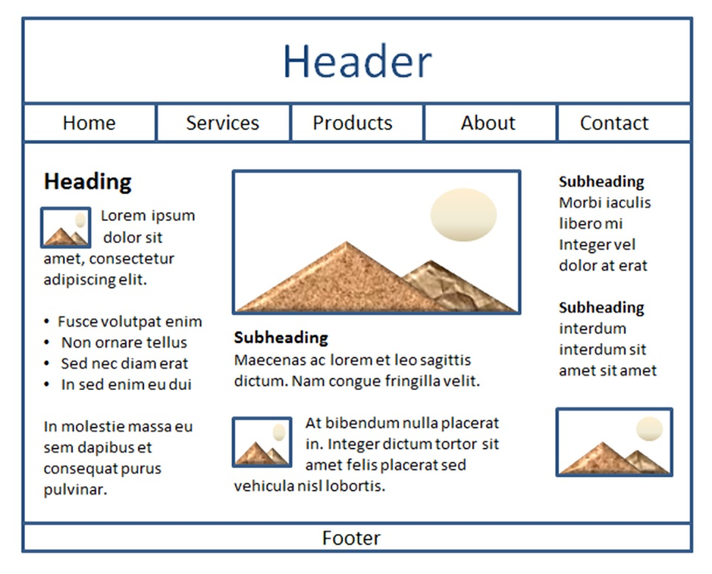
Wireframe
A sketch or blueprint of a web page
Shows the structure of the basic page elements, including:
Logo
Navigation
Content
Footer

Slide 32
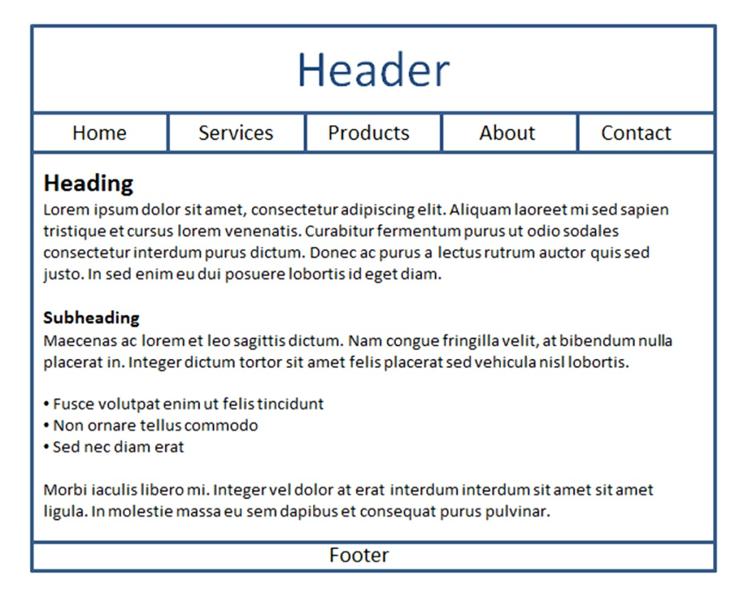
Web Page Design Page Layout (1 of 3)
Place the most important information "above the fold"
Use adequate "white" or blank space
Use an interesting page layout
This is usable, but a little boring. See the next slide for improvements in page layout.

Slide 33
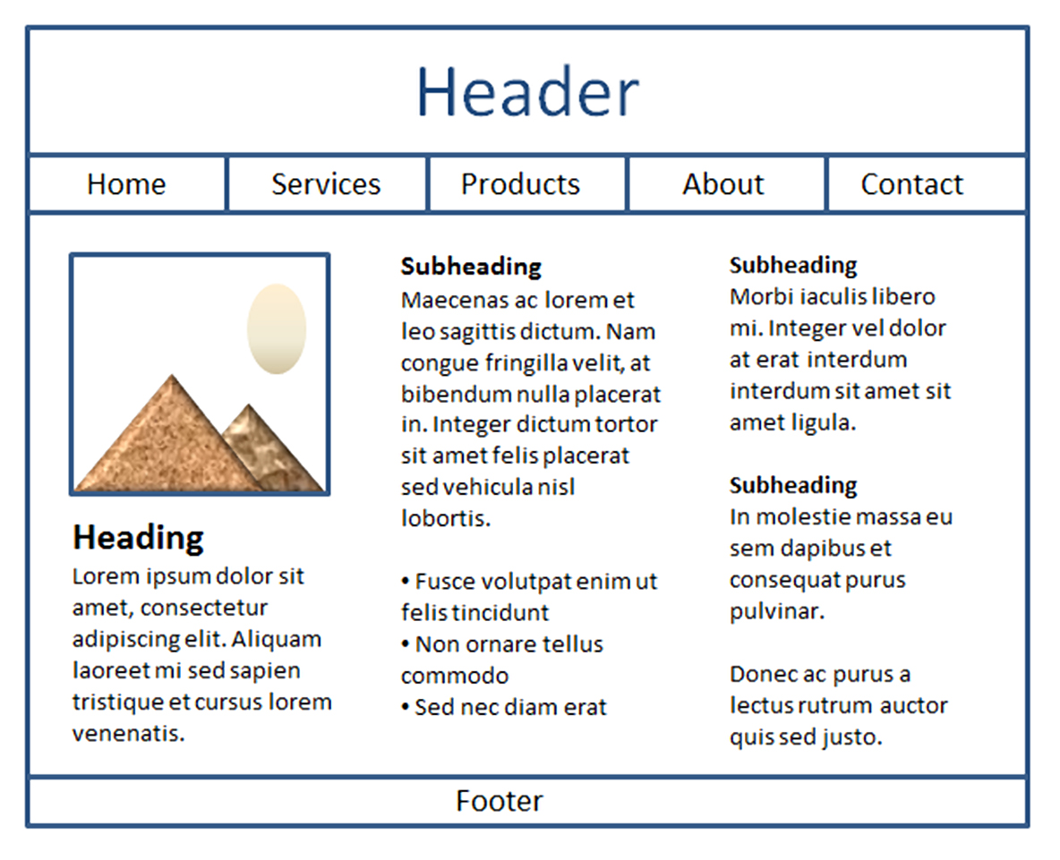
Web Page Design Page Layout (2 of 3)
Better
Columns make the page more interesting and it’s easier to read this way.

Slide 34
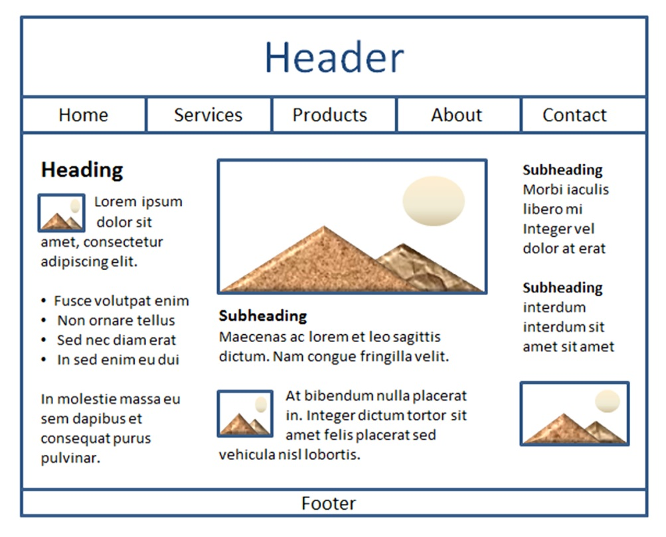
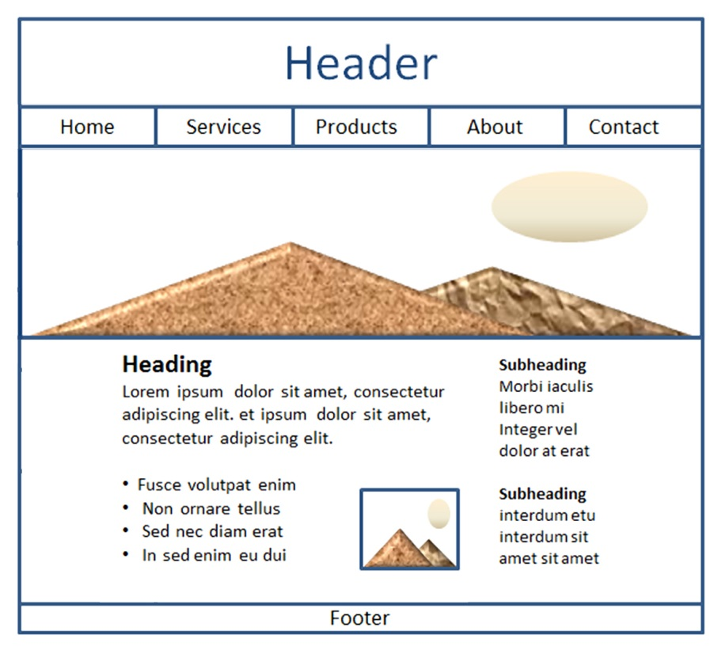
Web Page Design Page Layout (3 of 3)
Best
Columns of different widths interspersed with graphics and headings create the most interesting, easy to read page.

Slide 35
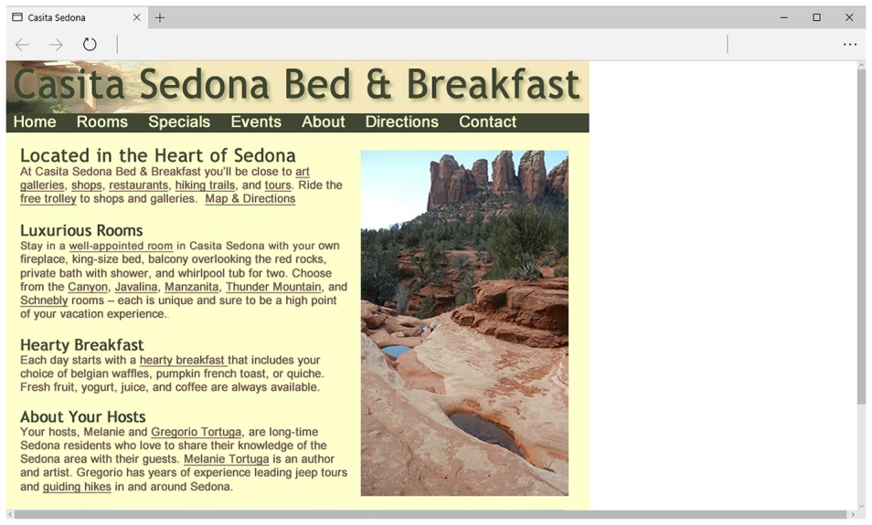
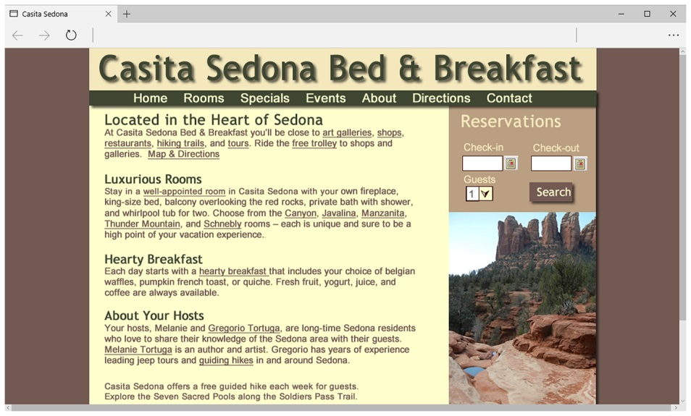
Page Layout Design Techniques (1 of 2)
Fixed Layout
A K A rigid or “ice” design
Fixed-width often at left margin
More appealing if fixed with content is centered

Slide 36
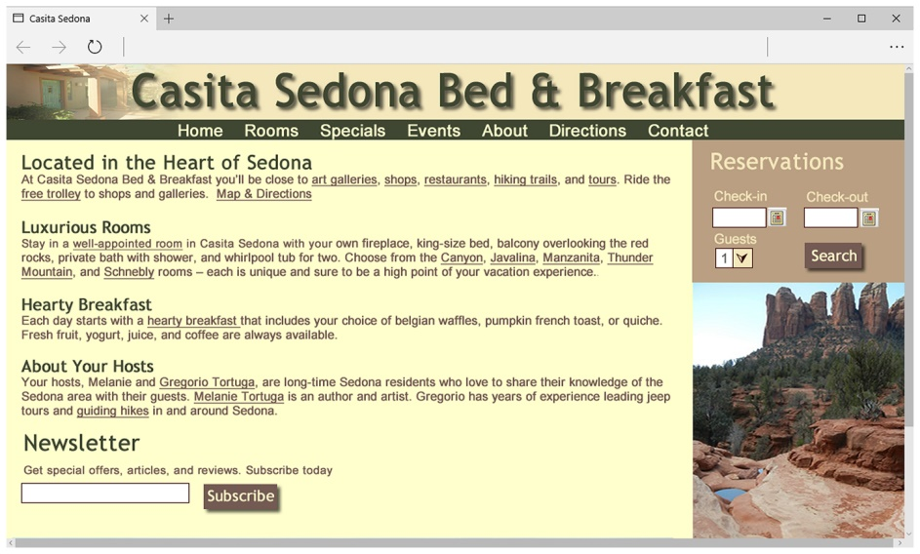
Page Layout Design Techniques (2 of 2)
Fluid Layout
A K A “liquid” design
Expands to fill the browser at all resolutions.
Adaptation:
Page content typically centered and often configured with a percentage width such as 80%

Slide 37
Design for the Mobile Web
P E W Research Center
77% of American adults own a smartphone
http://www.pewinternet.org/fact-sheets/mobile-technology-fact-sheet
Coding techniques to configure responsive web page layouts that display differently on desktop browsers and mobile devices will be introduced in Chapter 8.

Slide 38
Mobile Design Quick Checklist
Small screen size
Bandwidth issues
Single-column layout
Maximize contrast
Optimize images for mobile display
Descriptive alternate text for images
Avoid display of non-essential content

Slide 39
Responsive Web Design
Ethan Marcotte, noted web developer http://alistapart.com/article/responsive-web-design
Progressively enhancing a web page for different viewing contexts (such as smartphones and tablets) through the use of coding techniques, including flexible layouts and media queries.
Examples:
http://www.mediaqurie.es

Slide 40
Web Design Best Practices Checklist
http://terrymorris.net/bestpractices
Page Layout
Browser Compatibility
Navigation
Color and Graphics
Multimedia
Content Presentation
Functionality
Accessibility

Slide 41
Summary
This chapter introduced you to best practices of web design.
The choices you make in the use of color, graphics, and text should be based on your particular target audience.

Slide 42
Copyright
This work is protected by United States copyright laws and is provided solely for the use of instructors in teaching their courses and assessing student learning. Dissemination or sale of any part of this work (including on the World Wide Web) will destroy the integrity of the work and is not permitted. The work and materials from it should never be made available to students except by instructors using the accompanying text in their classes. All recipients of this work are expected to abide by these restrictions and to honor the intended pedagogical purposes and the needs of other instructors who rely on these materials.

